Slide 1
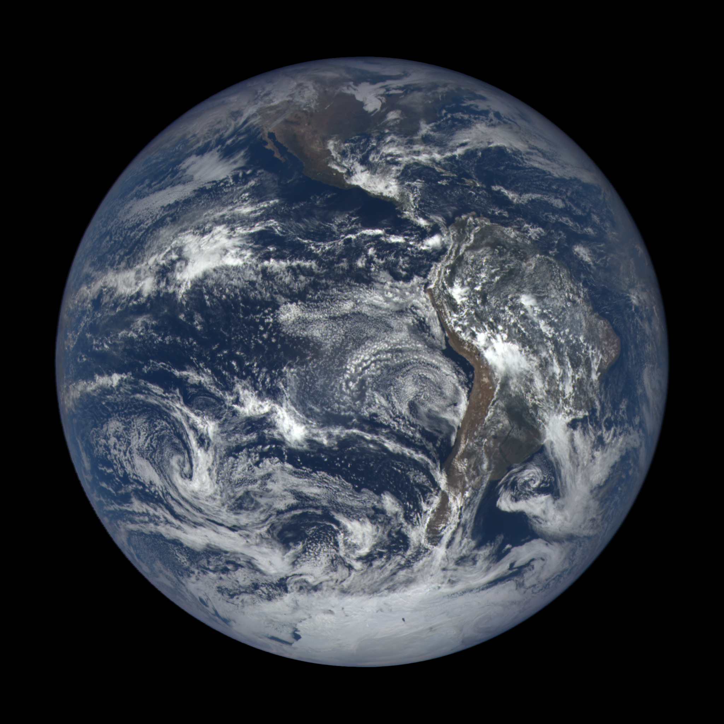

Collaborative REAnalysis Technical Environment
Jerry Potter
Laura Carriere
Judy Hertz
Mark McInerney
George Britzolakis
NASA GSFC Climate Model Data Services
DSCOVREPIC
Earth Polychromatic Imaging Camera

Slide 2
CREATE-IP as a use case
What reanalysis is all about
Preparing and publishing reanalysis in ESGF
Data production
Visualization – QC etc.
Agreements, issues, additional requests.

Slide 3
Reanalysis – what it is and who is doing it
Comprehensive record of past weather and climate. Observations and a weather forecast model are combined to produce the ~35-year record.
Only a few centers around the world produce a reanalysis
We have permission from these centers to repackage their reanalysis and distribute it through ESGF
ECMWF ERA-Interim
NOAA/NCEP CFSR
NASA/GSFC MERRA
NASA/GSFC MERRA2
20CR NOAA/ESRL
JMA JRA-55
JMA JRA-25
NOAA ESRL 20CRv2
ECMWF ERA20C

Slide 4
Why is putting reanalyses into ESGF important?
Used by climate scientists to study past trends in weather and climate and to study events such as droughts and hurricanes
Used to validate CMIP models
Fields that are not directly observed - complementary to obs4MIPs
Expanded version of ana4MIPs
Multiple reanalyses – help address uncertainty
Agreement among reanalyses promotes confidence
Disagreement suggests more uncertainty

Slide 5
Preparing reanalysis data for ESGF
Some reanalyses maintain their own data repository; ECMWF, CFSR and JRA-55 are also available at UCAR’s CISL site
Access to data
Web server
Wget
ftp
Python API
ECMWF has download restriction to 10GB per session
JRA-55 1 hour disconnect

Slide 6
Preparing data for ESGF (continued)
Other issues:
CISL GRIB-to-NetCDF changes attribute names
CISL reanalysis resolution are different than that from the individual repositories for ECMWF and NCEP
ERA-Interim CISL-256x512 vs ECMWF-241x480
CFSR
Processing with CMOR2 preparation requires a customized python wrapper
Templates for file dates
Monthly data is relatively easy

Slide 7
CREATE special problems
Processing CMOR 6 hour data (only the assimilation step)
CFSR and MERRA2 require 12-15 minutes per month per 3D variable
CMOR warnings are disabled for 6h data
Post-processing
Meta data correction – attributes modified
Units correction
Error in CMIP5 processing of ozone (S-RIP)

Slide 8
CMOR processing for inclusion into ESGF
Single processor for one 6h variable for MERRA2 requires 2-5 days per variable for 35 year period
Multiple variables can be processed simultaneously
Currently ~25TB for all the reanalyses
Expected to grow to 100TB with inclusion of 6 hour data

Slide 9
Quality control for CREATE
File information and metadata checks include an inventory of file size, date range, pressure levels, time bounds and more.
Grid, units, shape and reasonable min-mean-max
Plots of zonal average, time, selected levels for 3D data
QC is done on a Visualization server located at NASA/GSFC
UV-CDAT (v 2.2.0) both command line and GUI
Connected to a read-only file system where CMOR processing is done

Slide 10
QC plots generated on visgpu02
Comparison of zonal average clouds between MERRA and MERRA2

Slide 11
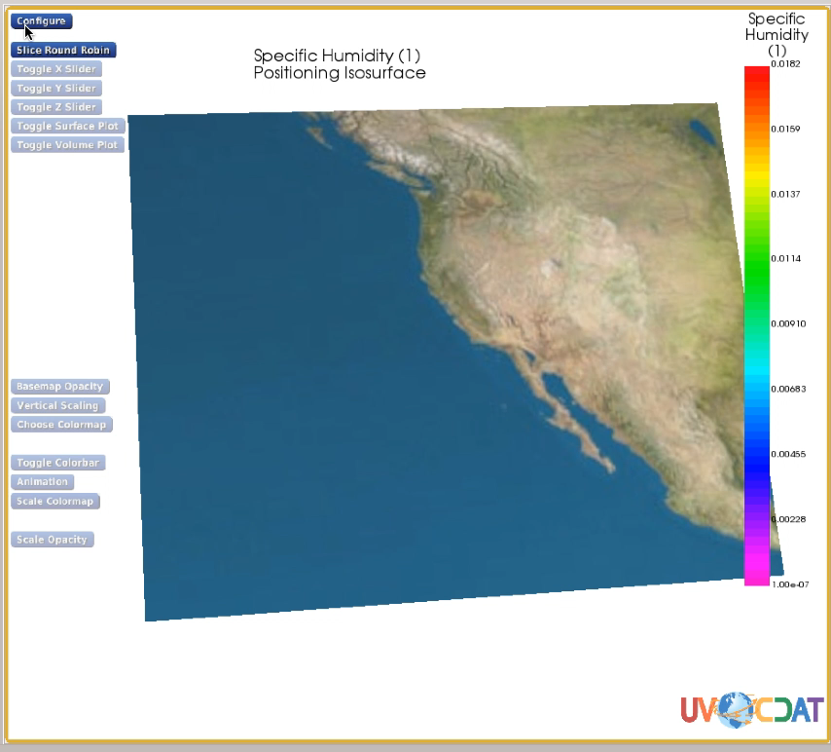

Slide 12
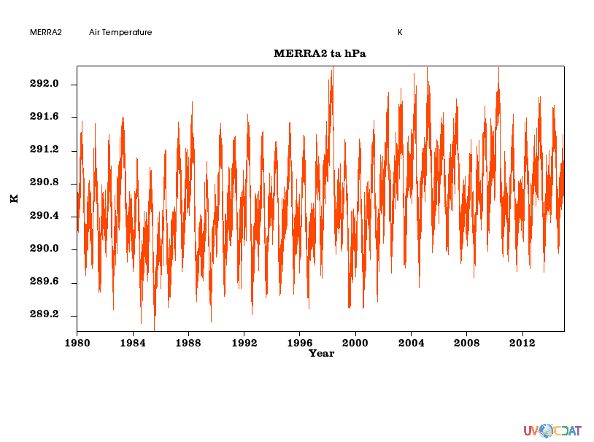
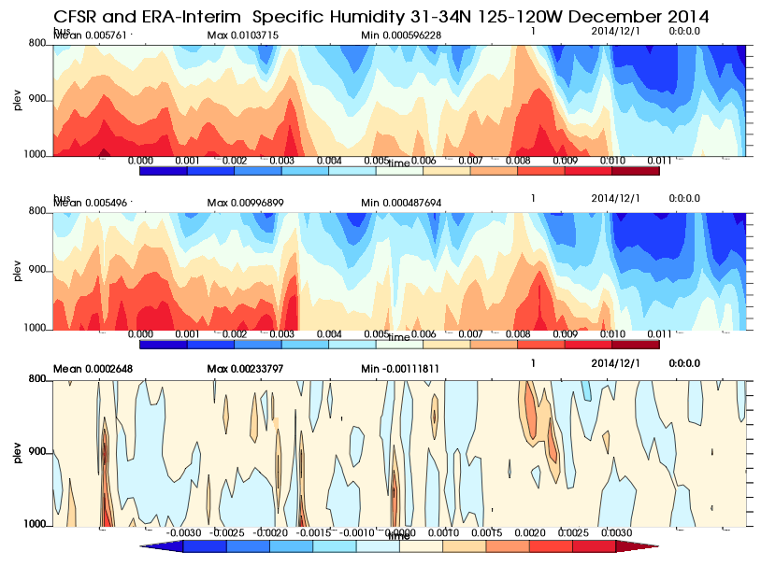
High frequency QC is an additional challenge
1 variable is ~ 2TB for reanalysis period
CFSR QC picked up a problem during a 2 week period in 1986
Pick 850 hPa and zonal average 20∘S to 20∘N.
Extract one level, then make .xml file with cdscan.
4.5x10¹¹ grid points for the entire time series
1 level = 1x10¹⁰ grid points
Specific humidity over Central California, December 2014
Air temperature at 850hPa (note impact of El Niño in 1998)

Slide 13
CREATE-IP: Schedule
(in planning)
PHASE 1
PHASE 3
PHASE 5
Extended Monthly Data to end of 2014
Next Six High Frequency Variables
Innovations and Observations
Variables: All available
Frequency: Monthly
Reanalyses: NASA/GMAO MERRA, ECMWF ERA-Interim, JMA JRA-25 and JRA-55, NOAA NCEP CFSR
Variables: Surface Temperature, Geopotential Height, Relative Humidity, Precipitation, Precipitable Water, Evaporation Rate, Surface Pressure, Ozone
Frequency: 6 hr
Reanalyses: NASA/GMAO MERRA (MERRA 2 monthly), ECMWF ERA-Interim, JMA JRA-55, NOAA NCEP CFSR
Variables: Assimilated state variables (temp, pressure, u-wind, v-wind, specific humidity)
Frequency: monthly, 6 hr
Reanalyses: TBD
TBD
Jul 2015
Aug 2015
Sep 2015
Oct 2015
Nov 2015
Dec 2015
Jan 2016
Feb 2016
Mar 2016
Apr 2016
May 2016
Jun 2016
PHASE 6
PHASE 2
PHASE 4
Extended available data to end of 2015
First Five High Frequency Variables
Process Newest Reanalysis
Variables: Sensible and Latent Heat Fluxes, Vertical Velocity, Cloud Fraction, Total Ozone Column, Radiation Fluxes
Frequency: Monthly and 6hr
Reanalyses: NASA/GMAO MERRA and MERRA2, ECMWF ERA-Interim and 20C, JMA JRA-55, NOAA NCEP/CFSR ESRL/20CR
Variables: Temperature, Sea Level Pressure, U-wind, V-wind, Specific Humidity
Frequency: 6hr (w/ 3hr for Sea Level Pressure)
Reanalyses: NASA/GMAO MERRA, ECMWF ERA-Interim, JRA-55, NOAA NCEP CFSR
Variables: All Phase 2 & 3 CREATE-IP Variables
Frequency: Monthly, 6hr
Reanalyses: NASA/GMAO MERRA2, ECMWF ERA-20C, NOAA ESRL 20CRv2c
NASA Climate Model Data Services (CDS) – http://cds.nccs.nasa.gov
13

Slide 14
Requests and Plans
S-RIP (SPARC Reanalysis Intercomparison)
Requested 6h Ozone
Include older reanalyses into CREATE
NCEP/NCAR
NCEP DOE
ERA40
Monthly Ensembles from 20CRv2
56 ensembles/month
CFSR
Monthly diurnal cycle (hourly values)
JMA wants full statistics about who is using their reanalysis

Slide 15
Plans
Work with reanalysis centers to add O-A and O-F
This has never been done but may provide valuable information about model differences and uncertainties
Include tendencies?
Additional variables

